Slide 1


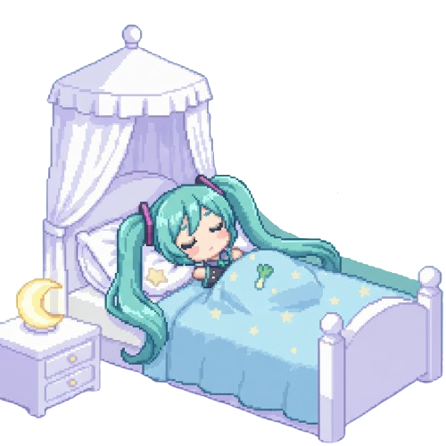

A Story About Sleep

Slide 2
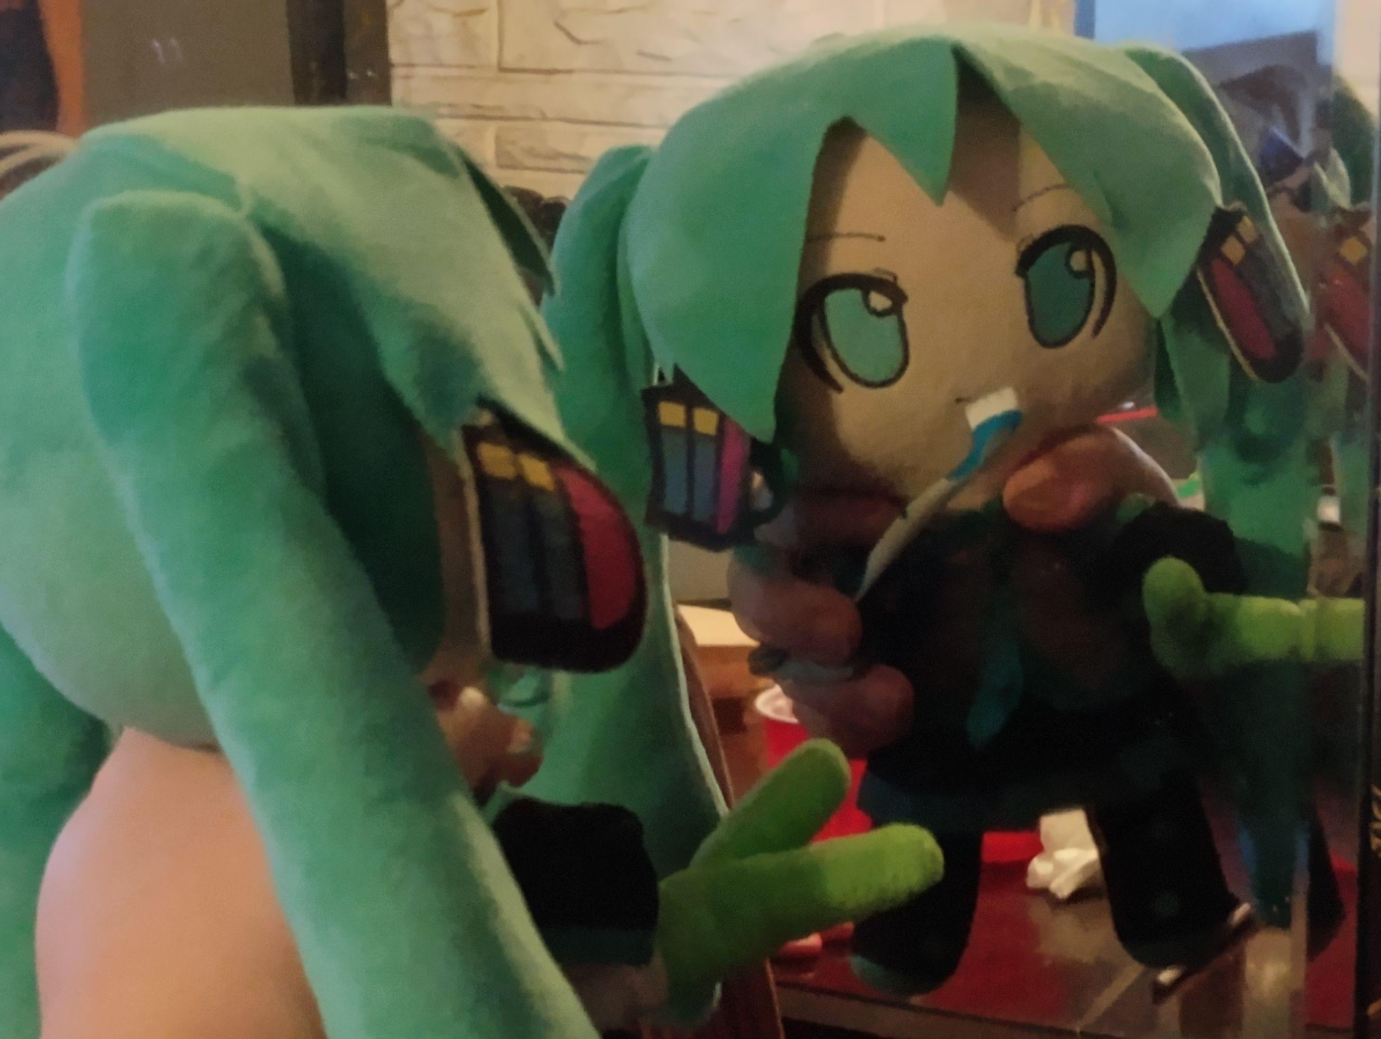
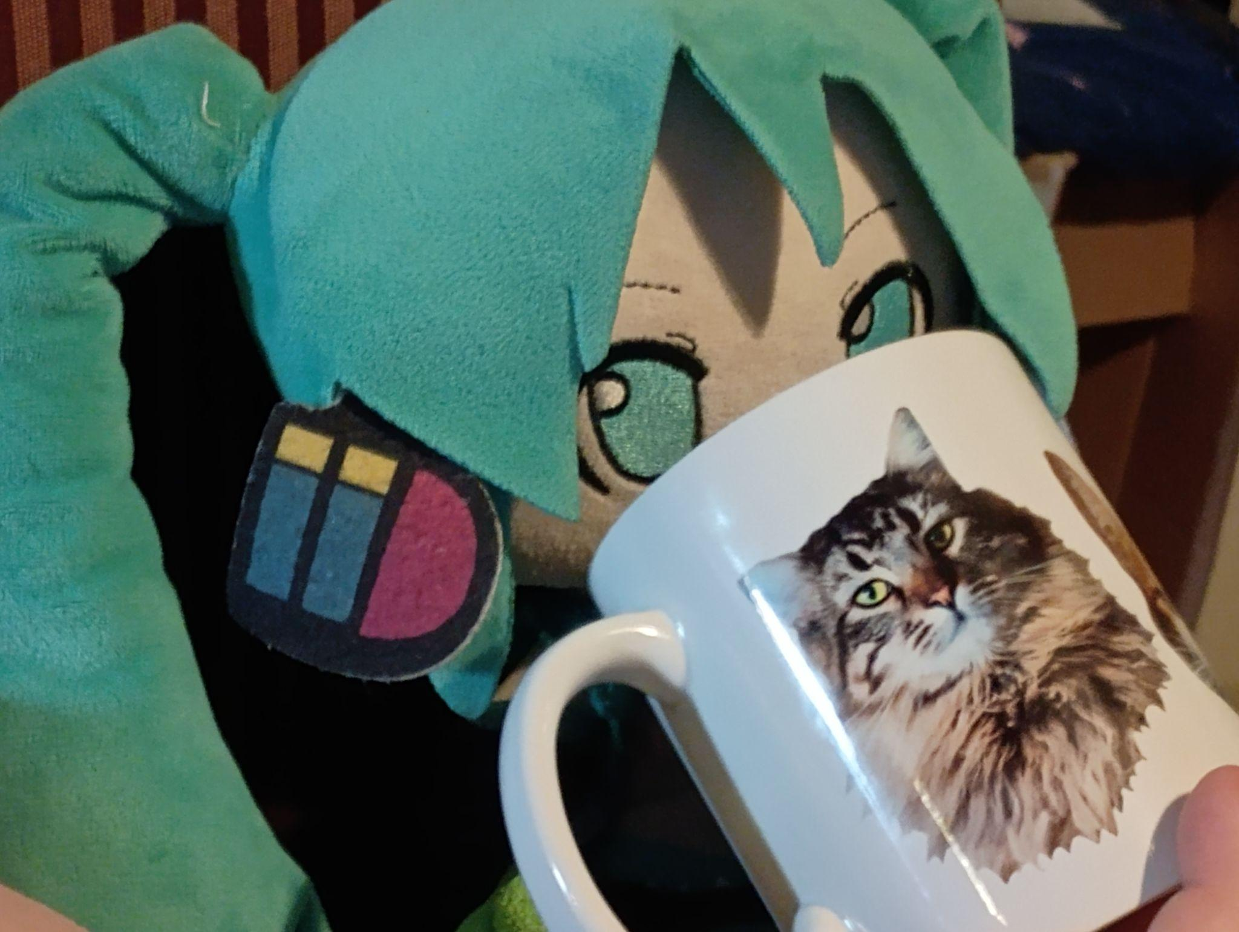
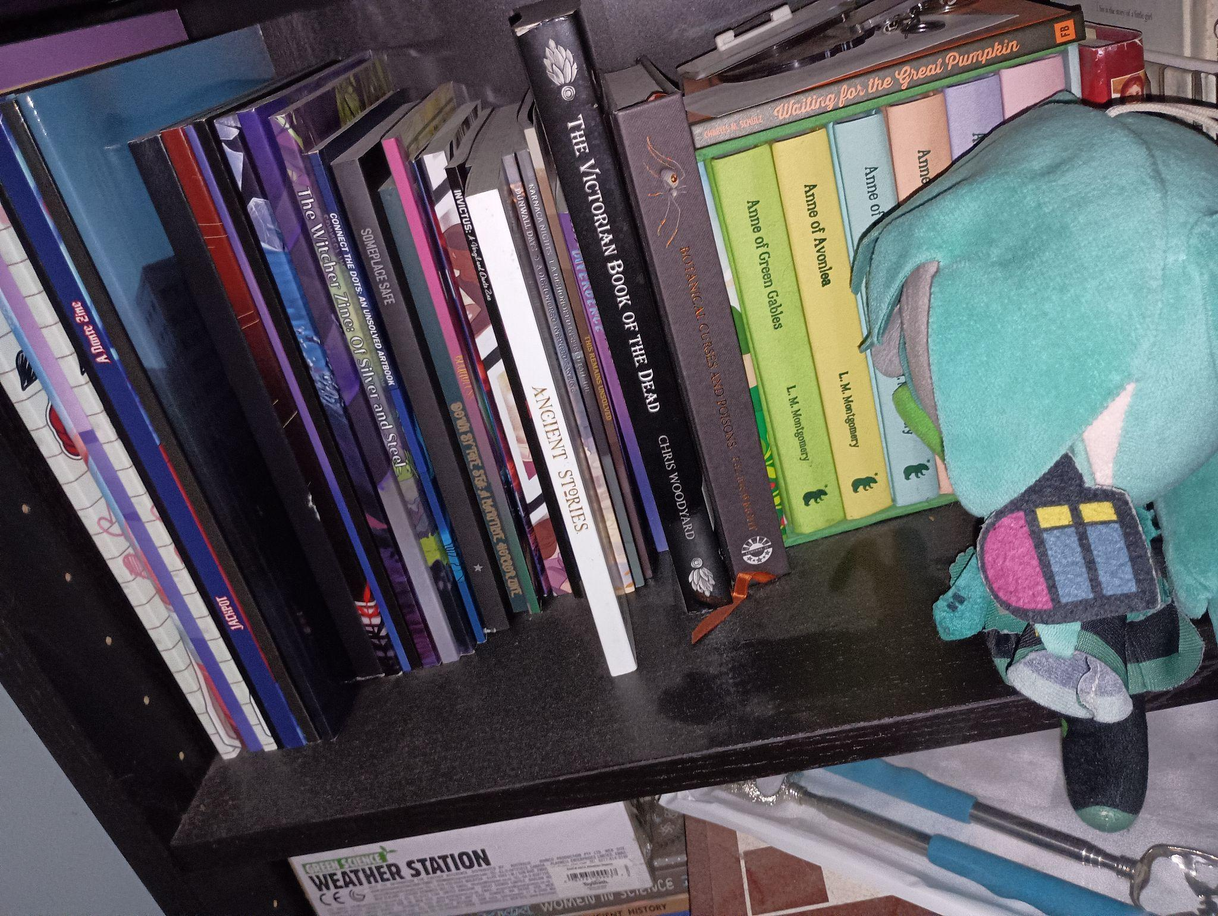

Hatsune Miku is getting ready for bed!
Has a glass of warm milk…
She brushes her teeth…
And picks out a bedtime story!

Slide 3

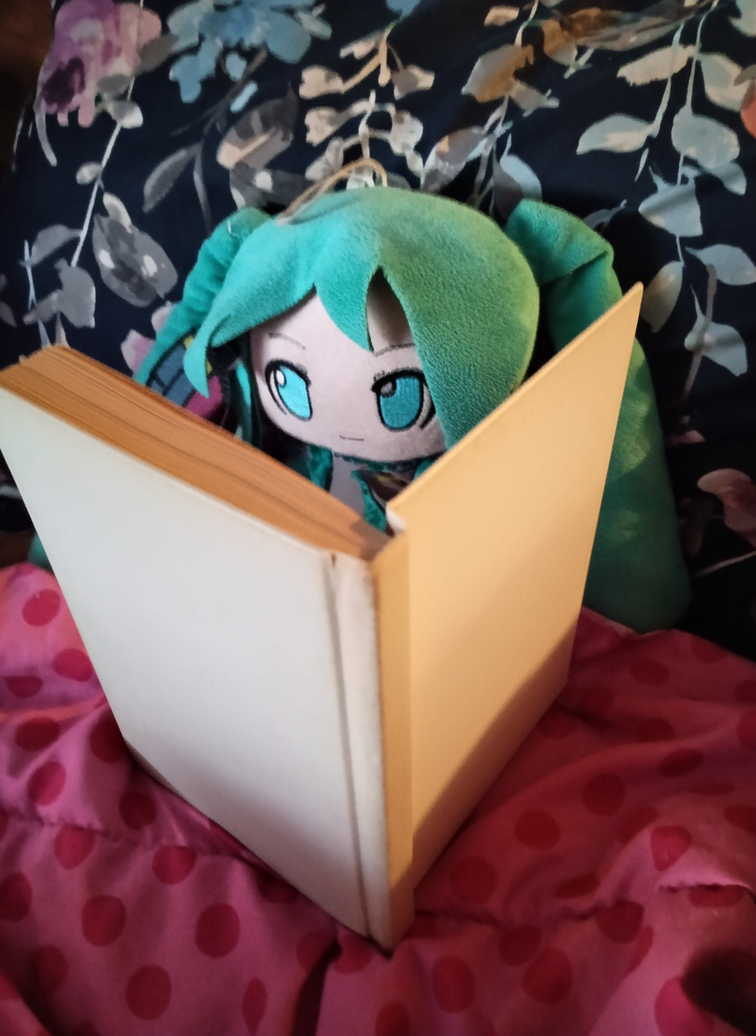
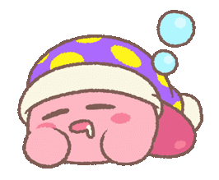
Miku wonders why she gets sleepy at night,
so she picked out a book about sleep!
Sleep is a state of consciousness, which means it’s a state your brain can be in.
You need to sleep because your brain and body are hard at work all day, and need a lot of rest for the next day!

Slide 4
Now Miku knows why she has to sleep.
But what happens when she’s sleeping?
The first stage of sleep is when you’re in your bed, first starting to get tired. You close your eyes and try to fall asleep…
…and it works!
At this point you’re sleeping very lightly. Anything could wake you up.

Slide 5
What happens next?
The second stage of sleep is when your body starts to relax. Your heart slows down, and your breathing slows, too.
Your body gets a little colder and your muscles are all relaxed. Your body is preparing itself to sleep for a while!

Slide 6
What happens after that?
The third stage of sleep is when your brain starts to repair itself from all the work it’s done throughout the day.
It flushes out any toxins it picked up, and calms itself down.

Slide 7
What’s the final stage?
The last stage of sleep has a special name: R.E.M sleep. This is where your dreams happen!
Your brain activity is highest during R.E.M. sleep. You imagine little pictures in your head, like a bedtime movie!

Slide 8
Miku knows what happens when she sleeps. Great!
But she has another question: why does she dream?
Miku begins to wonder all on her own, since the book doesn’t tell her anything about this.
‘Maybe dreams could be me trying to handle my biggest feelings, or maybe it’s showing me my favorite & least favorite memories…’

Slide 9
That’s an interesting thought, Miku!
Wait, there’s one more part to the book!
Some people don’t sleep regular amounts, and some people don’t sleep at all. We call these sleep disorders. Let’s go over a few of them.
Insomnia is when you can’t sleep at all.
Sleep Apnea is when you can only sleep in short amounts.
Narcolepsy is when you’re sleepy all the time!
Sleepwalking is when you get up and walk around, but you’re not awake..

Slide 10
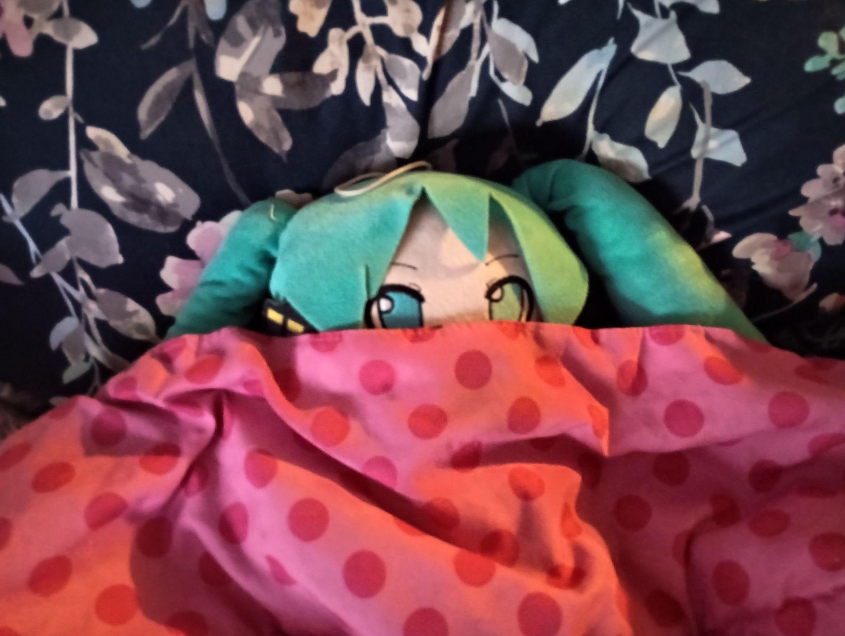
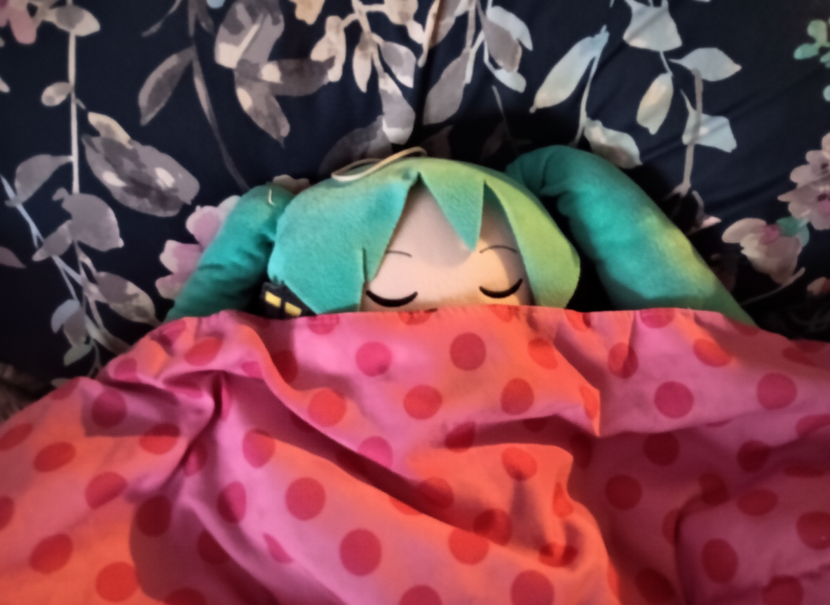
That was a very fun book!
Now that Miku knows all about what happens when she’s asleep, she can go to bed safe and sound!
She’s already looking a little tuckered out…
Goodnight, Miku!

