Slide 1
Family link bypass

Slide 2
IMPORTANT NOTES
ALL data will be lost after the process
You WILL need access to a google account that was linked to the device to complete setup
Your parents will most likely never let you get near a smartphone if they find out 💀

Slide 3
Step 1: download adb and fastboot
You will need to download the Android SDK Platform Tools or if you don’t need the whole android SDK, simply download a minimal installer here and simply install the software like any other windows app

Slide 4
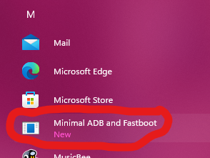
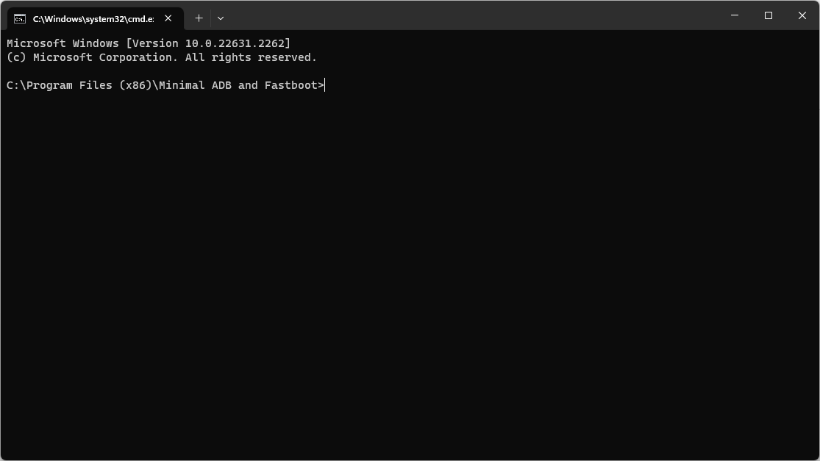
Open the app
You should see a terminal window open

Slide 5
Power off the device
Pretty self explanatory

Slide 6
Enter recovery mode
The method differs from device to device
Search “enter recovery mode [your device model]” for instructions for your specific android device

Slide 7
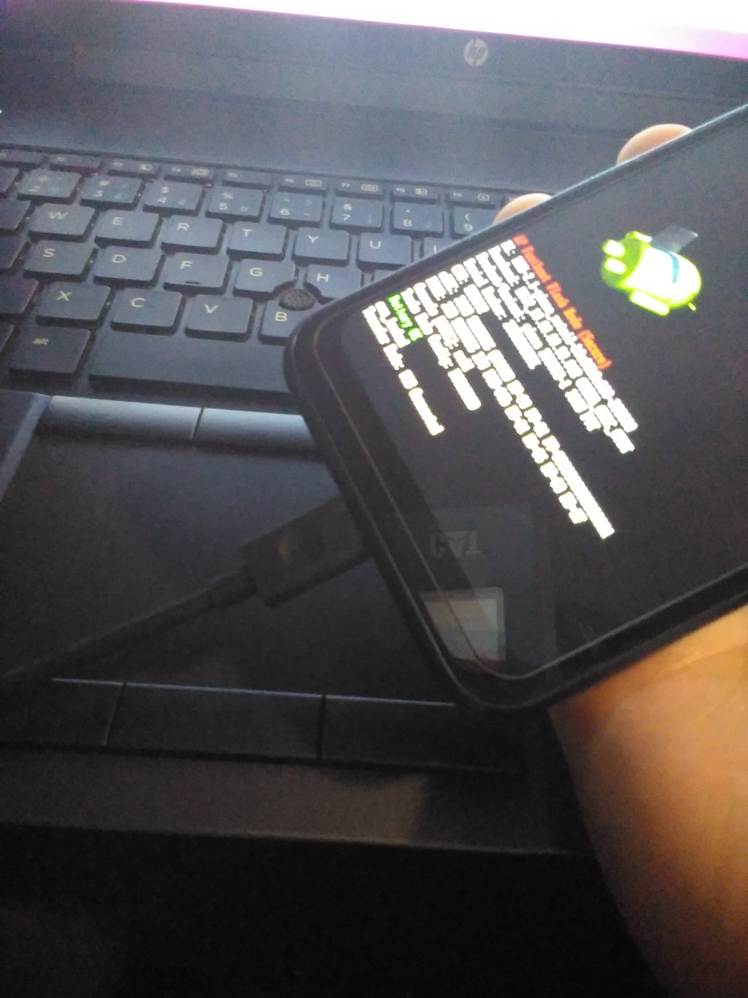
Connect your device to your pc
Once in recovery mode, connect the usb cable from your device to your pc

Slide 8
Time for some commands
Type fastboot devices in the terminal
You should see some random characters with fastboot next to it like the image below if everything is working

Slide 9
Factory resetting your device
Once the device is recognized in fastboot you will try 2 commands
First try fastboot erase data
If you get a permission denied error try
fastboot -w
Note that ALL data will be lost after this step

Slide 10
Reboot the device
Use the volume buttons to select power off then press power to select
Hold power to power on the device

Slide 11
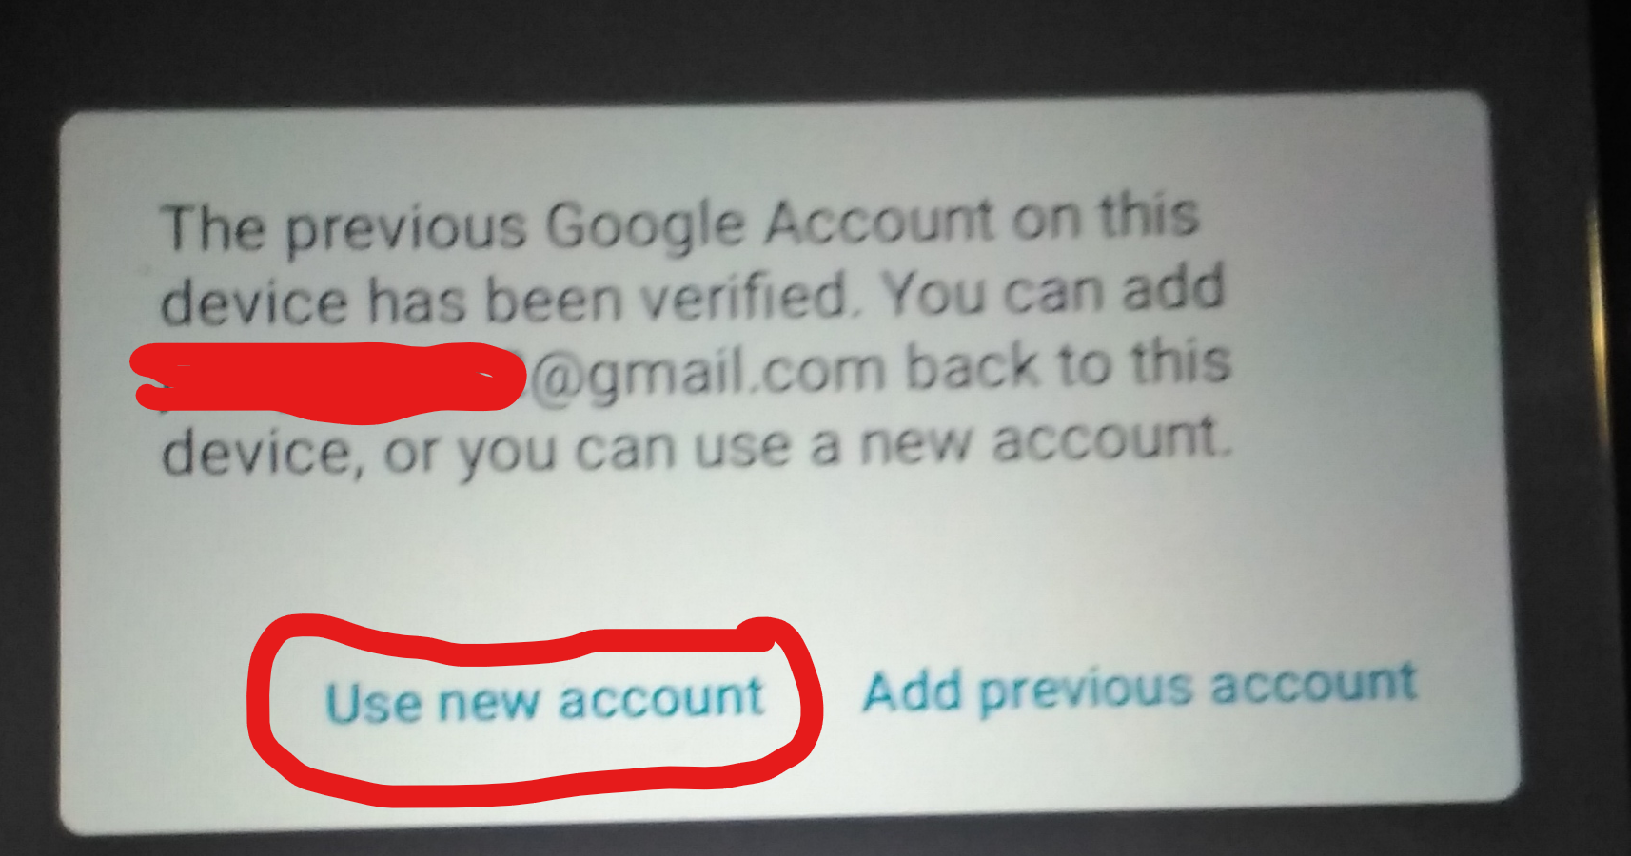
Set up the device as you normally would
When asked to verify your account, log in to an account that was used on this device
When asked to add that account back, select “use new account”
Create a new account, log in to an account that isn’t supervised or skip adding an account altogether

Slide 12
Have fun
Your device is now like new

