Slide 1
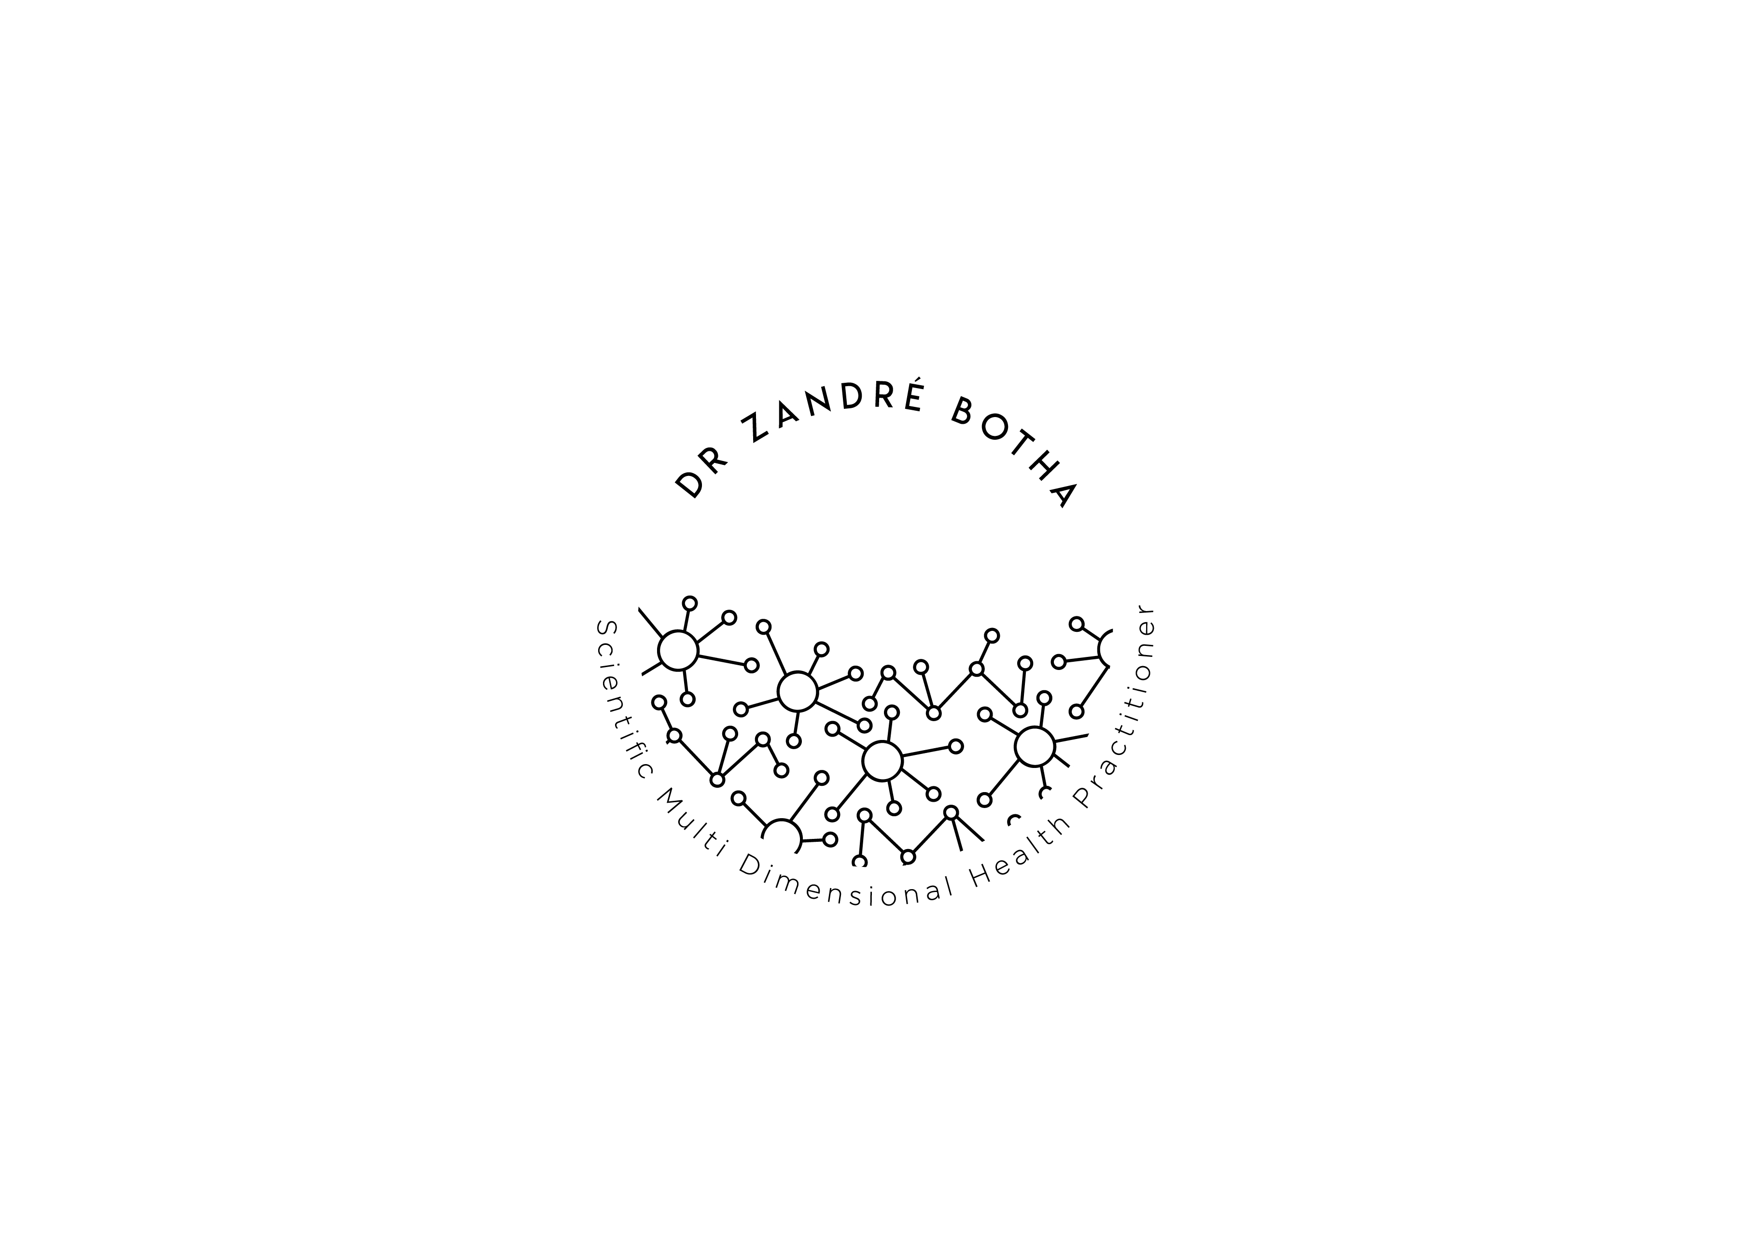
Before and after photos of patients that have been receiving treatment protocol post jab.

Slide 2
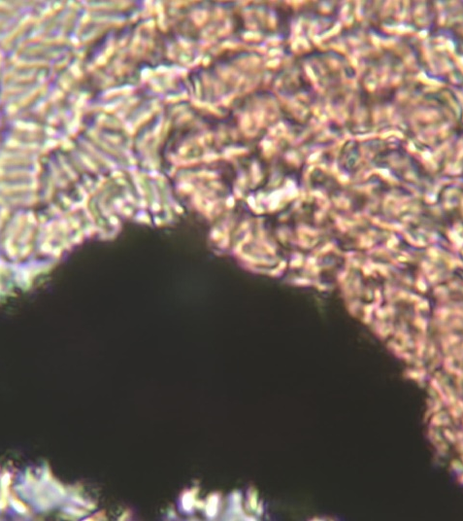
Before
After

Slide 3
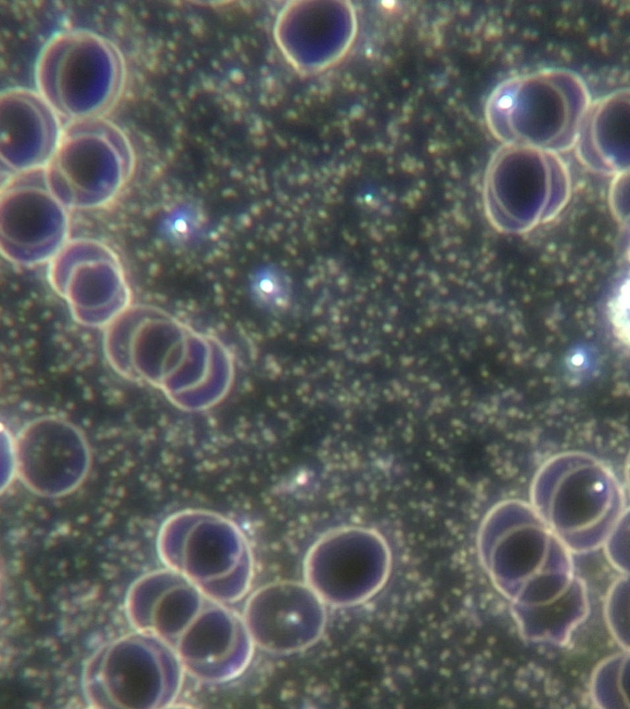
Before
After

Slide 4
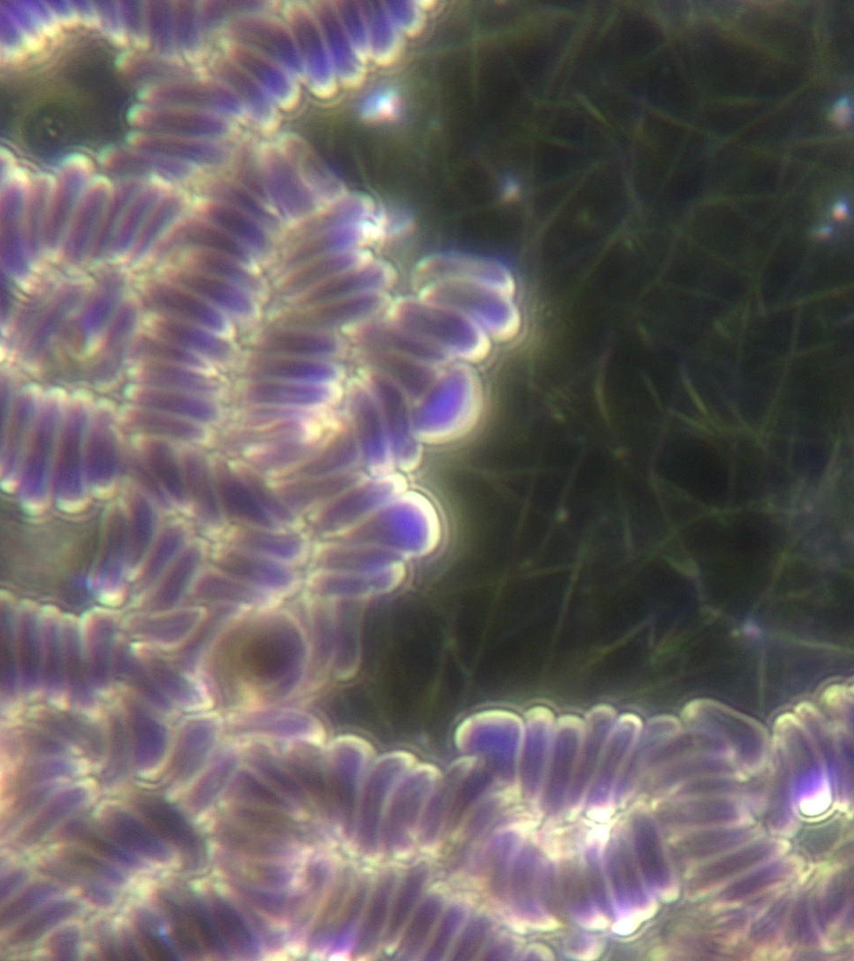
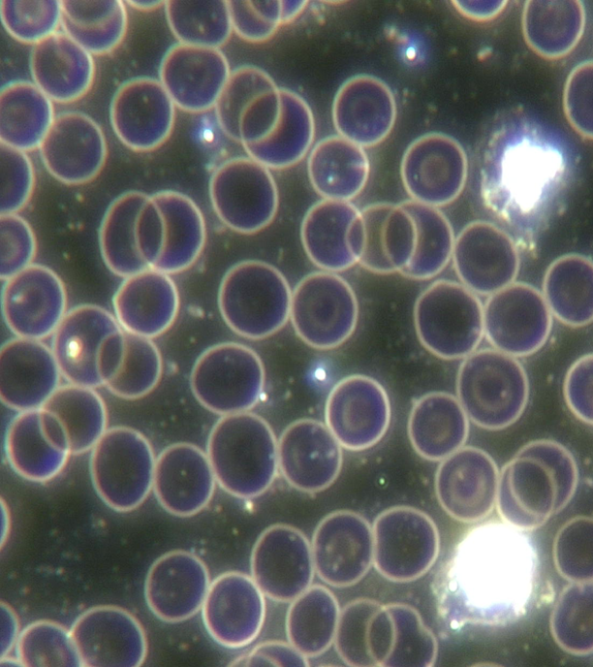
Before
After

Slide 5
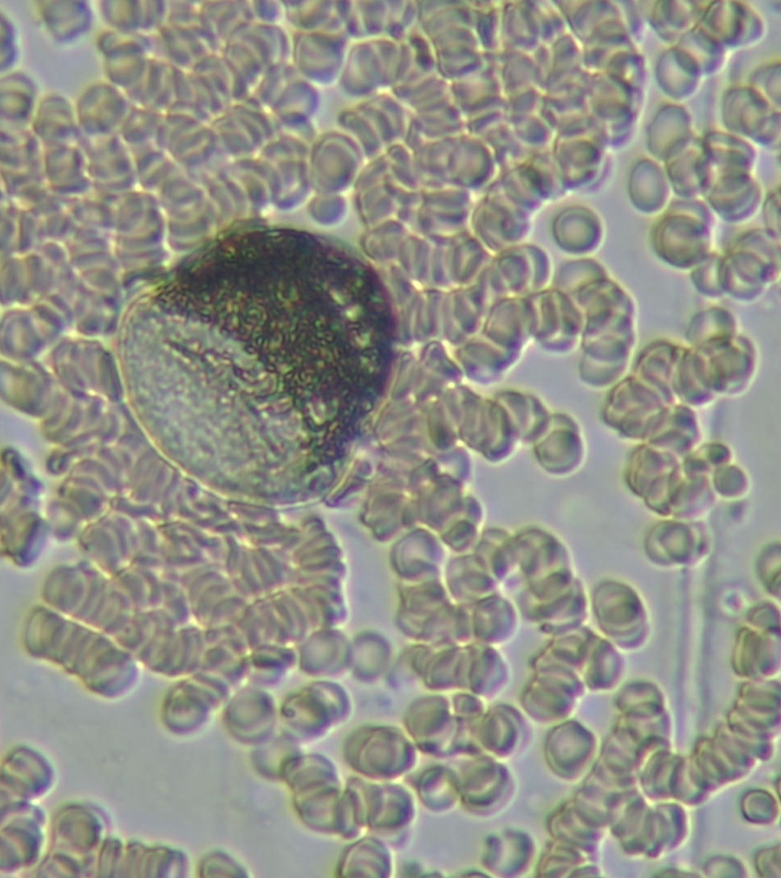
Before
After

Slide 6
Before
After

Slide 7
Treatment protocol post jab.
Nutraceuticals & Treatment

Slide 8
Treatment protocol post jab for mild symptoms.
Nutraceuticals :
Anti coagulant
Thrombocyte, aspirin, curcumin/turmeric, garlic
Ivermectin 12mg x 1 pd for 5 days then 1 per week
NAC 500mg x 3 per day
Oxygen capsules / blood oxygenator
Hydro shot- Molecular hydrogen in pill form
Zeolite chemicals, radiation, metals
Colloidal silver, drink and nebulize as well as chlorine dioxide
D 5000mg
Alkaline powder
Miracle booster detox (super foods) and DNA repair

Slide 9
Treatment protocol post jab for mild symptoms.
Treatments :
Molecular Hydrogen
Ozone Therapy
Rife Therapy: ATP / DNA repair
Comra Laser Therapy

Slide 10
The Caring Healthcare workers coalition have had multiple round table meetings and recently held the African health summit and dedicated one of the three days entirely to detox protocols medical and natural medicine Doctors have been using to help their patients with great success.

